Slide 1
SOCI354 FINAL PROJECT
Dila Gürer

Slide 2
ANALYSIS 1: LINEAR REGRESSION: Happiness level in relation to social support level in the country
Hypotheses:
H0(1): There is no significant relationship between happiness scores and level of social support in a country.
H1(1): There is a significant relationship between happiness scores and level of social support in a country: Increase in social support is associated with an increase in happiness scores in a country.

Slide 3
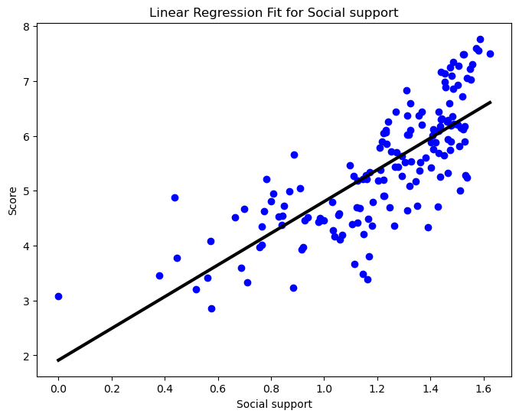
Results
For every one-unit increase in social support, the predicted happiness score increases by approximately 1.1477.
H1 is accepted, there is a significant association between happiness scores and social support level in a country.

Slide 4
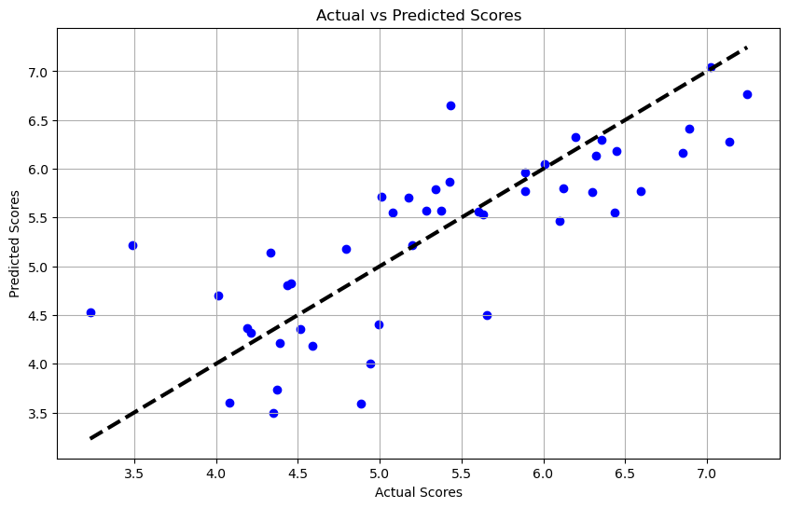

Slide 5
Model Evaluation
Mean Squared Error: 0.98: A lower MSE indicates a better fit of the model to the data. In this case, an MSE of 0.98 suggests that on average, the squared difference between the predicted and actual happiness scores is around 0.98 units
R^2 Score: 0.7368467575719668: An R² score of approximately 0.737 means that about 73.7% of the variance in the happiness score is explained by the model. This suggests a strong relationship between the predictors and the happiness score.
Cross-Validation Scores: [-5.57285067 -5.9477523 -6.23988074 -8.84930385 -2.39521998]: The negative values indicate that the model performed poorly on these validation sets, which could be due to overfitting on the training data or variability in the data
Root Mean Squared Error: 0.6386463842144325: An RMSE of approximately 0.639 indicates that, on average, the model's predictions differ from the actual happiness scores by around 0.639 units.

Slide 6
Lasso Coefficients: [1.35429473 0.40532089 0. 0. 0. 0. ]: Here, only the first two predictors have non-zero coefficients, suggesting that the Lasso model considers only these two predictors (likely the most important ones) in explaining the happiness score
R^2 Score (Lasso): 0.6664963334361766 : about 66.0% of the variance in the happiness score is explained by the predictors.
R^2 Score (Ridge): 0.6673941235948362: about 66.7% of the variance in the happiness score is explained by the predictors. This score is lower than the linear regression model but higher than the Lasso model, indicating a moderate level of regularization that balances bias and variance.

Slide 7
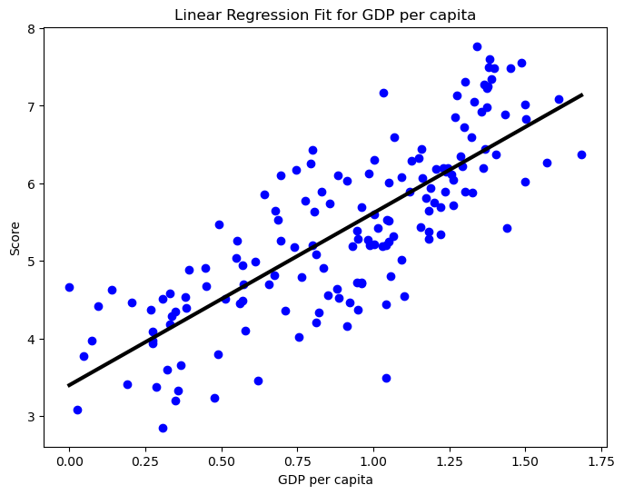

Slide 8
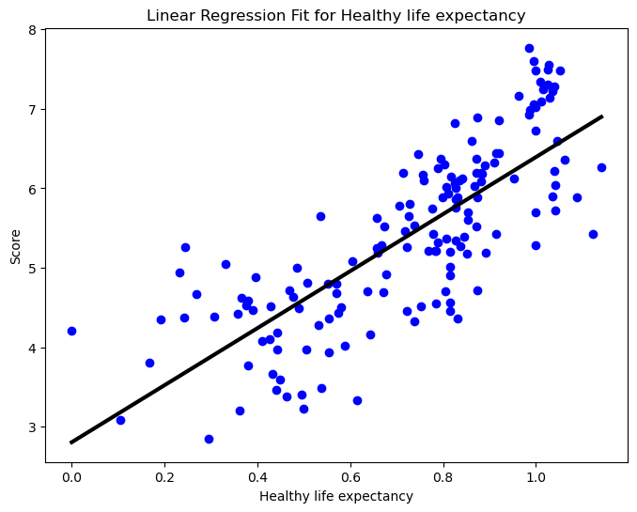
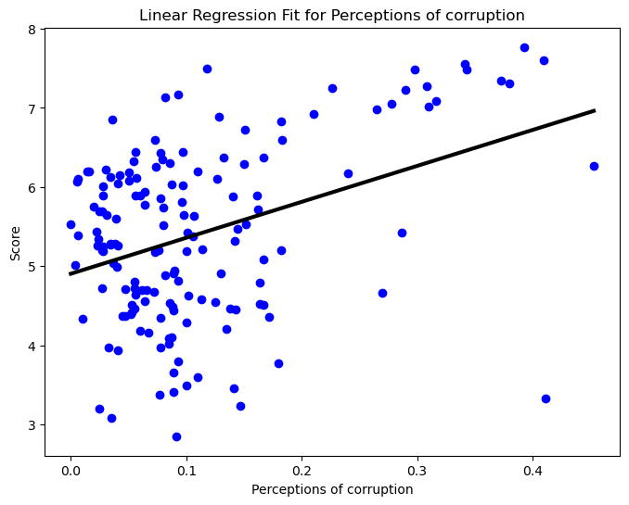
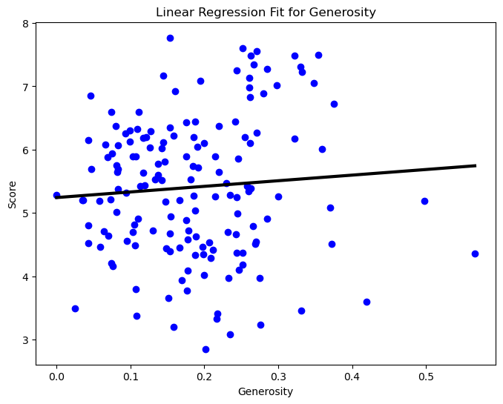
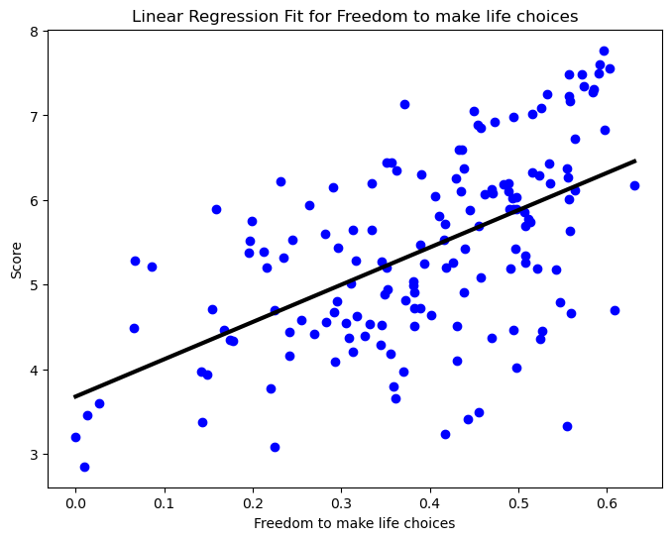

Slide 9
OLS Regression Results
The R² value of 0.791 comes from an OLS regression performed on the entire dataset using the statsmodel library. This value represents how well the model fits the entire dataset without separating it into training and testing sets.
Social support:
Coef: 1.1477
P-value: 0.000
Interpretation: A one-unit increase in social support is associated with an increase of approximately 1.1477 in the happiness score. This predictor is highly significant.

Slide 10
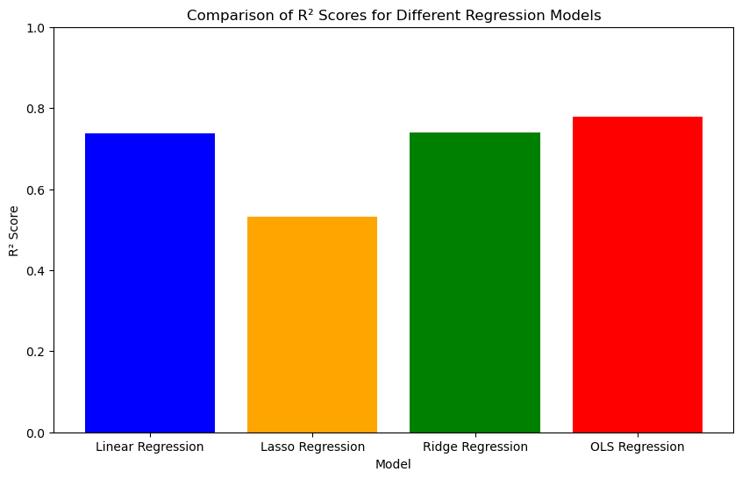
Interpretation of the Plot
Interpretation of the Plot
Linear Regression: Shows how well the linear regression model fits the test data.
Lasso Regression: Demonstrates the performance of the Lasso model with L1 regularization, typically lower R² due to its feature selection property.
Ridge Regression: Demonstrates the performance of the Ridge model with L2 regularization, balancing between the fit and regularization.
OLS Regression: Reflects the model fit on the entire dataset, which is generally higher as it includes the training data in the evaluation.

Slide 11
Analysis 2 : LOGISTIC REGRESSION: Happiness level in relation to social support level
Hypotheses:
H0(1): There is no significant relationship between being happy & unhappy and the level of social support in a country.
H1(1): There is a significant relationship between being happy & unhappy and the level of social support in a country: Increase in social support is associated with an increase in the likelihood of being happy compared to being unhappy.

Slide 12

Result
Logistic Regression Intercept: -7.054138917215498
Logistic Regression Coefficients:
GDP per capita: 1.6267428370389814
Social support: 1.480992204134107: 7: A one-unit increase in Social support is associated with an increase in the log-odds of being happy by 1.48. H1 is accepted, there is a significant association between happiness scores and social support level in a country.
Healthy life expectancy: 1.396284986920191
Freedom to make life choices: 0.25172957535536006
Perceptions of corruption: 0.36306356224808306
Lasso Coefficients:
GDP per capita: 1.1251083192593825
Social support: 0.8735533594961641: A one-unit increase in Social support is associated with an increase in the happiness score by approximately 0.87 units. H1 is accepted, there is a significant association between happiness scores and social support level in a country.
This positive coefficients indicates that higher Social support is associated with higher happiness scores.
Healthy life expectancy: 1.5622147427709918
Freedom to make life choices: 0.26251801680768827
Perceptions of corruption: 0.842877219980052

Slide 13
Model Evaluation
Accuracy: 0.851063829787234
Cross-Validation Scores: [0.6875 0.96774194 0.87096774 0.87096774 0.74193548]
Mean Cross-Validation Score: 0.8278225806451613
The cross-validation scores range from 0.6875 to 0.96774194, indicating a variation in performance across different folds of the data.
The mean cross-validation score, which is 0.8278225806451613, represents the average performance of the model across all folds. This value indicates the overall effectiveness of the model in capturing the relationship between the predictors and the target variable.
Mean Squared Error (MSE): 0.10638297872340426
Root Mean Squared Error (RMSE): 0.3261640365267211: The Root Mean Squared Error (RMSE) is the square root of the MSE and represents the average magnitude of the errors in the predicted values. The RMSE value of 0.3261640365267211 indicates that, on average, the difference between the predicted and actual values is approximately 0.326. In summary, both the MSE and RMSE provide insights into the accuracy of the predictions made by the model. Lower values of MSE and RMSE indicate better performance, suggesting that the model's predictions are closer to the actual values.
Pseudo R² Score: 0.5115876602606143: The Pseudo R² score is a measure of the goodness of fit of a statistical model, particularly in regression analysis. It provides an indication of how well the independent variables explain the variation in the dependent variable. In your context, a Pseudo R² score of 0.5115876602606143 indicates that approximately 51.16% of the variance in the dependent variable is explained by the independent variables included in the model.

Slide 14
Lasso Logistic Regression Accuracy: 0.8936170212765957
Best alpha for Lasso: 0.0011719128787983544: Indicates that the optimal alpha for Ridge regression was found to be 0.1.
R² Score (Lasso): 0.736525633365397: The R² score for the Lasso regression indicates that approximately 73.65% of the variance in the dependent variable (target) is predictable from the independent variables (features) using the Lasso regression.

Slide 15
Ridge Logistic Regression Accuracy: 0.8723404255319149
Best alpha for Ridge: {'alpha': 0.1}
R² Score (Ridge): 0.7386395153144539: Similar to Lasso, the R² score for Ridge regression indicates that approximately 73.86% of the variance in the dependent variable is predictable from the independent variables using the Ridge regression

Slide 16
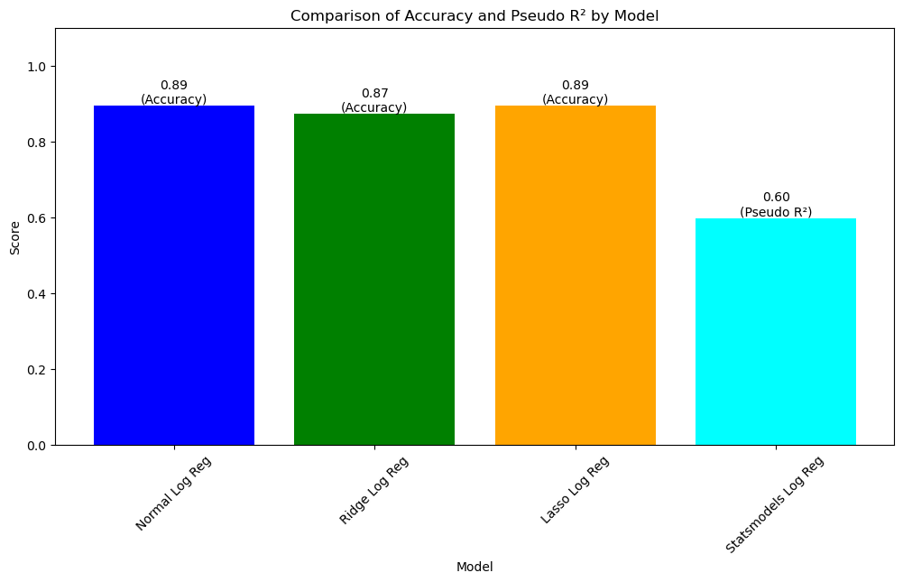
Ridge Logistic Regression Classification Report:
Precision: The ratio of correctly predicted positive observations to the total predicted positives. Precision for Class 0 is 0.84 and for Class 1 is 1.00.
Recall: The ratio of correctly predicted positive observations to all the observations in the actual class. Recall for Class 0 is 1.00 and for Class 1 is 0.60.
F1-score: The weighted average of Precision and Recall. F1-score for Class 0 is 0.91 and for Class 1 is 0.75.
Lasso Logistic Regression
Precision: The ratio of correctly predicted positive observations to the total predicted positives. Precision for Class 0 is 0.86 and for Class 1 is 1.00.
Recall: The ratio of correctly predicted positive observations to all the observations in the actual class. Recall for Class 0 is 1.00 and for Class 1 is 0.67.
F1-score: The weighted average of Precision and Recall. F1-score for Class 0 is 0.93 and for Class 1 is 0.80.

Slide 17

Overall Interpretation
Both Lasso and Ridge logistic regression models show high accuracy, precision, and recall for Class 0 (negative class), but the recall for Class 1 (positive class) is lower, indicating some misclassification in predicting the positive class in Ridge logistic regression.
The Lasso model appears to perform slightly better in terms of accuracy and recall for the positive class compared to Ridge.

Slide 18
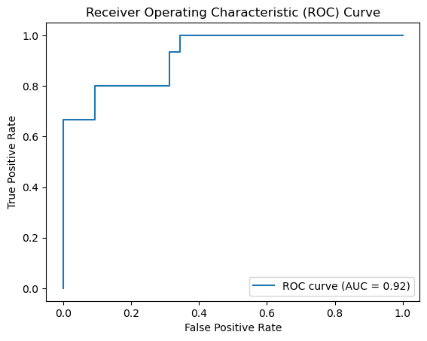
AUC: 0.92: An AUC of 0.92 indicates that there is a 92% chance that the classifier will be able to distinguish between positive and negative classes correctly. This is a high value, suggesting that the model has excellent performance in distinguishing between the two classes.

Slide 19
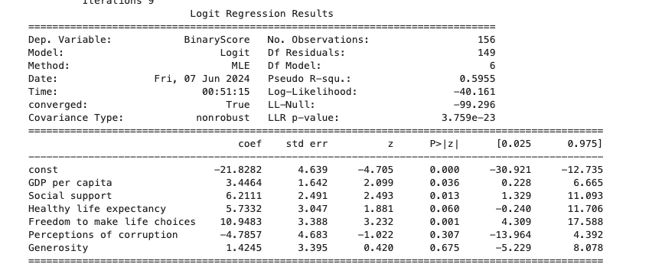
Summary The model is statistically significant overall, as indicated by the LLR p-value. Key predictors such as GDP per capita, social support, and freedom to make life choices are significant and positively associated with the binary outcome. The relatively high pseudo R-squared value suggests that the model explains a good portion of the variability in the binary outcome.

Slide 20
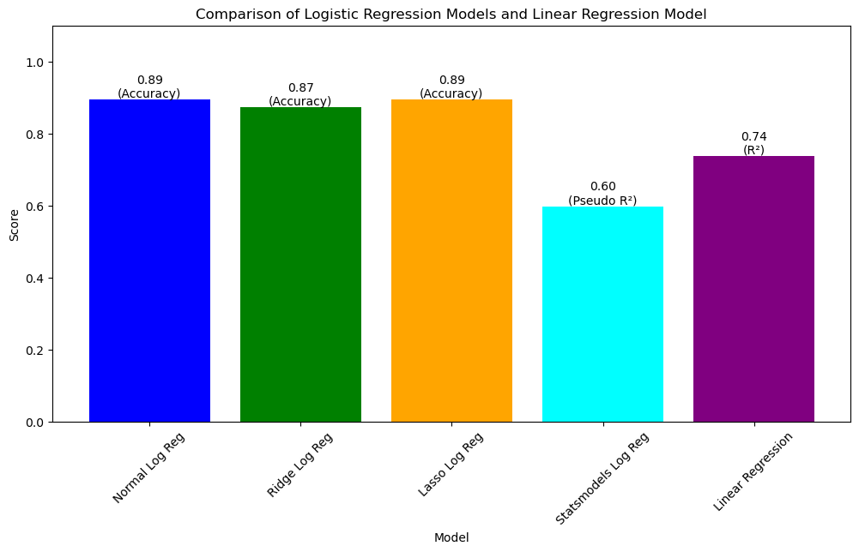

Slide 21
Analysis 3:Linear Regression: Happiness Levels in relation to Continent Hypotheses: H0(2): There is no significant relationship between happiness scores and living in a country in Europe. H1(1): There is a significant relationship between happiness scores and living in a country in Europe. Living in Europe is associated with an increase in happiness scores compared to not living in Europe.

Slide 22
Results: Since the coefficients are positive and not equal to zero, this suggests that there is evidence to support the alternative hypothesis (H1). Living in Europe is associated with a statistically significant increase in happiness scores compared to not living in Europe
The linear regression model has the highest MSE and RMSE among the three models, indicating a larger average squared difference between the predicted and actual values.
All models have similar R² scores, indicating that they explain approximately 17-18% of the variance in the target variable.
The coefficients of the Is_Europe predictor variable are relatively close across all models, suggesting that being in Europe has a similar impact on the predicted score in each model.
For Linear Regression: The coefficient of Is_Europe is 1.190, indicating that, on average, living in a European country is associated with an increase in happiness scores by 1.190 units compared to not living in Europe.
For Lasso Regression: The coefficient of Is_Europe is 1.135, suggesting a similar interpretation as above.
For Ridge Regression: The coefficient of Is_Europe is 1.139, which also aligns with the interpretation provided by Linear and Lasso Regression.

Slide 23
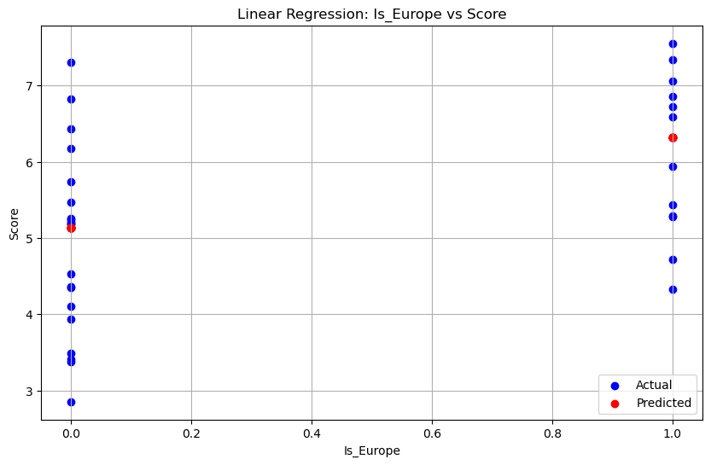

Slide 24
Model Evaluation
Mean Squared Error (MSE): 1.3162814595959718: This metric measures the average squared difference between the predicted values and the actual values. In the linear model, the MSE is approximately 1.3163, while in Lasso, Ridge, and the improved linear model, it is 1.0444. A lower MSE indicates better model performance.
Root Mean Squared Error (RMSE): 1.1472931009972873: RMSE is the square root of the MSE and provides a measure of the average magnitude of the errors in the predicted values. The linear model has an RMSE of approximately 1.1473, while the others have the same RMSE as the MSE. Again, lower values are desirable.
R² Score: 0.17215126960468774: The R² score, also known as the coefficient of determination, measures the proportion of the variance in the dependent variable that is predictable from the independent variables. In the linear model, the R² score is approximately 0.1722, indicating that about 17.22% of the variance in the dependent variable is explained by the independent variable.

Slide 25
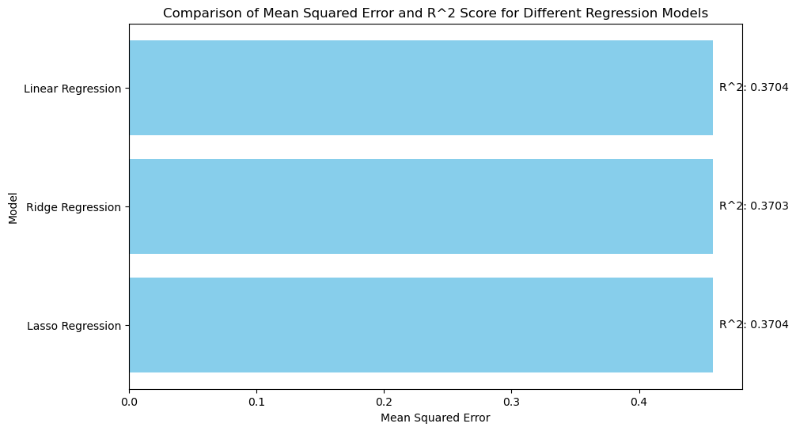

Slide 26
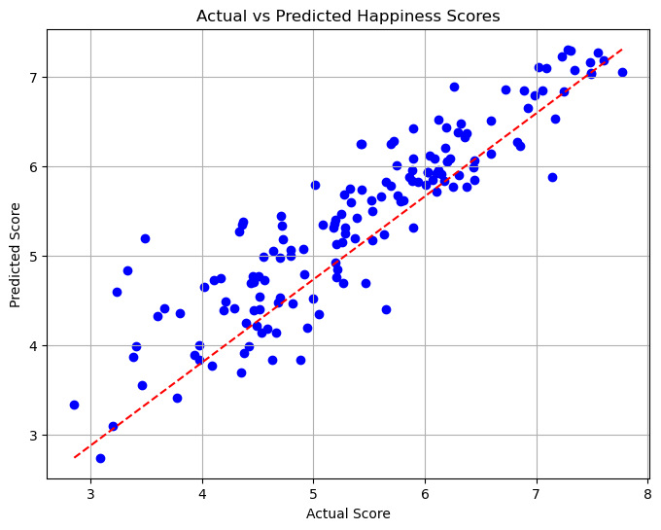

Slide 27
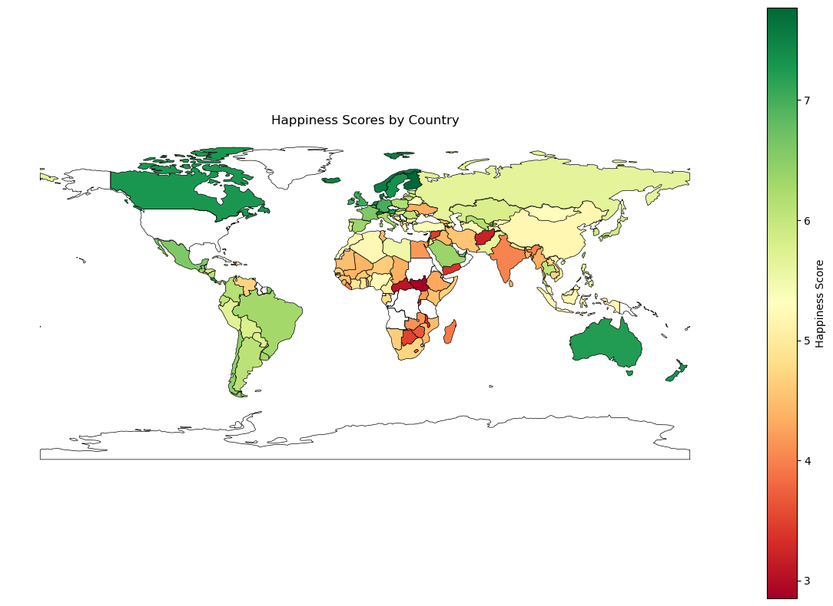

Slide 28
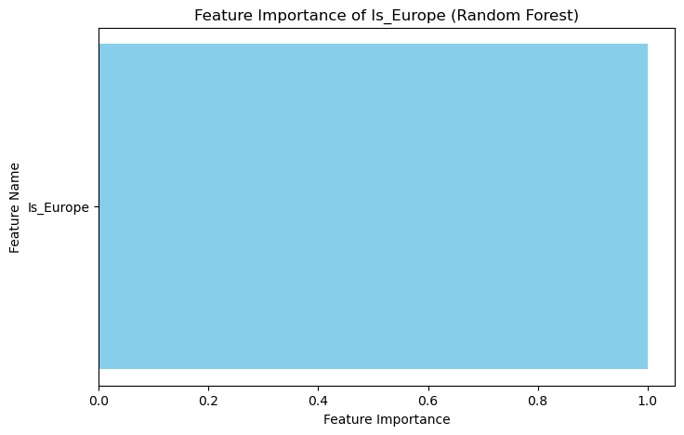
Random forest modeling

Slide 29

R^2 Score on Testing Set (Random Forest): 0.17579930048754733
Feature Importance (Is_Europe): 1.0
The Random Forest model's feature importance of 1.0 for Is_Europe supports H1(1), indicating that there is a significant relationship between happiness scores and living in a country in Europe. Furthermore, it suggests that living in Europe is strongly associated with an increase of 1.1 in happiness scores compared to not living in Europe, as Is_Europe is the most important feature in predicting happiness scores according to the Random Forest model.

Slide 30
Analysis 3: other factors included
R^2 Score on Testing Set (Random Forest with multiple variables): 0.7474060993836442
Feature Importances: [0.00204356 0.12089449 0.48371644 0.24985969 0.06996415 0.0464603 0.02706136]
Mean Squared Error: 0.40162490559062575

Slide 31

R^2 Score on Testing Set (Random Forest with multiple variables): 0.7474060993836442
The R² score indicates the proportion of the variance in the dependent variable (happiness score) that is predictable from the independent variables using the Random Forest model.
An R² score of approximately 0.747 means that 74.7% of the variance in the happiness score is explained by the predictors included in the model. This suggests a strong relationship between the predictors and the happiness score, and indicates that the Random Forest model has a good fit.
Feature Importances: [0.00204356 0.12089449 0.48371644 0.24985969 0.06996415 0.0464603 0.02706136]
The coefficient for Is_Europe is approximately 0.235.
This coefficient represents the average change in the happiness score for countries in Europe compared to countries not in Europe, holding all other predictors constant.
Mean Squared Error: 0.40162490559062575: The Mean Squared Error (MSE) measures the average squared difference between the actual and predicted values.
An MSE of approximately 0.402 indicates that, on average, the squared differences between the actual happiness scores and the predicted scores by the Random Forest model are 0.402 units. Lower MSE values indicate better model performance.

Slide 32
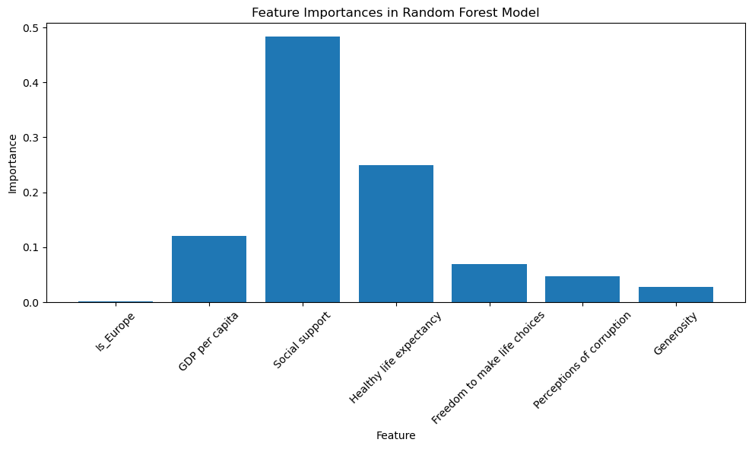

Slide 33

Mean Squared Error (MSE): 0.38041227086962087
Root Mean Squared Error (RMSE): 0.6167757054794075
R² Score: 0.7607473590314962
Coefficient of Is_Europe: 0.23540731665880985
Coefficient of GDP per capita: 0.7083550339710856
Coefficient of Social support: 1.0785913651072891
Coefficient of Healthy life expectancy: 0.9508426954623314
Coefficient of Freedom to make life choices: 1.6156442736882448
Coefficient of Perceptions of corruption: 0.2811869157470659
Coefficient of Generosity: 0.5871626032326751

Slide 34
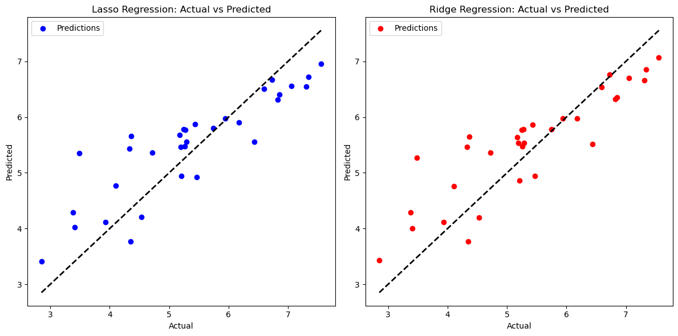

Slide 35
